Slide 1
Surface detection from Image
SAMSUNG PRISM END REVIEW REPORT
Working Team Details:
1.College Professor(s): Dr. Rajarajeswari S and Dr. Sini Anna Alex
2.Samsung Mentor: Akhilesh Parmar
3.Students:
i) Haarish Anandan(CSE)
ii) Tejas Hedge(CSE)
iii) Rahul Kumar(ECE)
iv) Satyam Satyarthi(ECE)
v) Pranamya Kashyap MP( PG _ CSE)

Slide 2
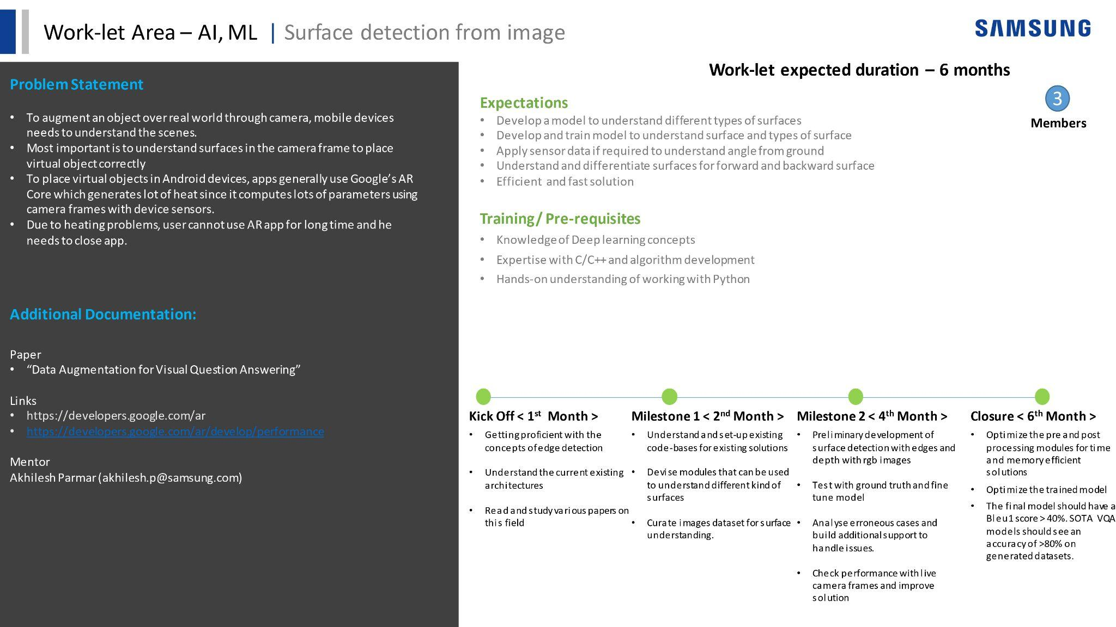

[Samsung PRISM] End Review Report
[ NAME OF WORK-LET]
Working Team Details [Name & Email ID] :
College Professor(s):
Students:
XX
XX
XX
XX
Department:
Date: 5 Nov 2019

Slide 3
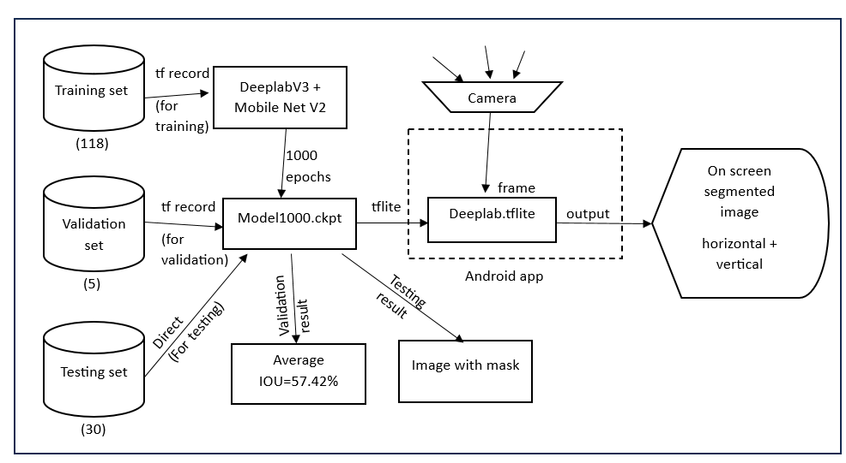
Approach / Solution
Concept Diagram :
( Clear detailed schematic / block diagram / flow chart depicting the proposed concept / solution )

Slide 4
Dataset(s) Analysis / Description
Dataset Capture / Preparation / Generation :
(Discuss the dataset generation process or if downloaded data provide details of what data & from where it was obtained etc… - 2 to 3 bullets only)
The dataset which has been used to train the models has been manually procured by the team members.
Majority of the images (around 75%) have been captured by mobile phones in our day-to-day lives including but not limited to scenarios in our own homes and classroom environment.
The remaining images have been selected from stock images and unsplash.
The images were curated such that only .jpg and .png files were used in the training process.

Slide 5
Dataset(s) Analysis / Description
Dataset Understanding / Analysis :
(Provide 2 to 3 bullets about what is your understanding of the data / opinion about the data)
Classification
The dataset has been divided into 3 distinct classes: flat surfaces, vertical surfaces and slant surfaces
The image type is RGB color coding.
Flat surface: 463 images, Vertical Surface: 474 images, Slant surface: 203 images
Segmentation
The dataset has been divided into three parts: train, validation and test.
Train: Consists of 118 segmented images, validation: Consists of 5 segmented images, test: Consists of 30 unsegmented images. Segmented images have two parts: horizontal surface and vertical surface
The whole dataset is in COCO format.

Slide 6
Dataset(s) Analysis / Description
Dataset Pre-Processing / Related Challenges (if any) :
(List out the challenges you fore see in data handling wrt problem definition – 2 to 3 bullets only)
Dataset Pre-Processing:
Leveraged the tool segments.ai for the process of manual segmentation and labelling of images. Two separate segments datasets were created one each for train and validation.
Segments.ai supports the modern COCO panoptic/instance segmentation format.
In order to enhance quality of images, we performed bilinear interpolation and also opening and closing of images.
Challenges:
Rebuilt the DeepLab framework to train on segmentation datasets such as PASCAL VOC dataset.
Manual segmentation and labelling was a time consuming process with limited time.
Required to build code that converts our dataset into COCO instance format.
Required to produce code to make our dataset compatible with the DeepLab framework.

Slide 7
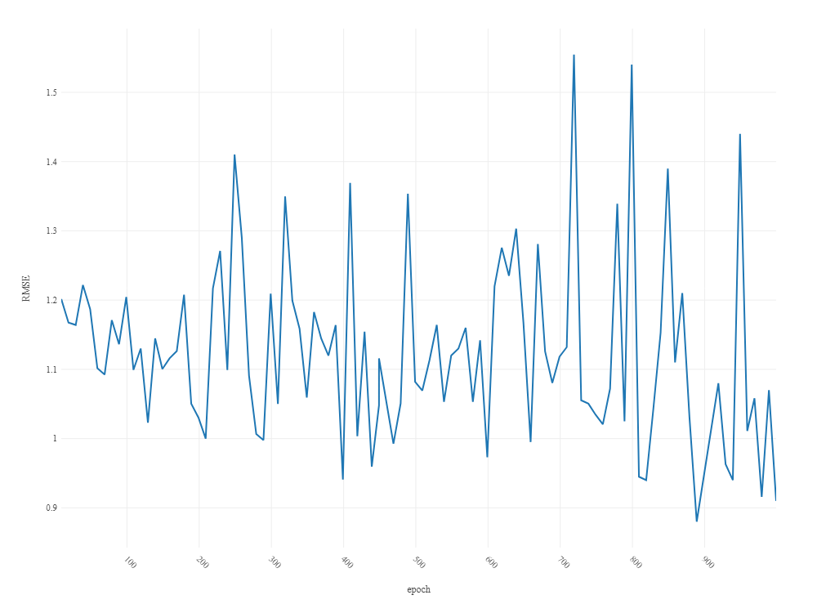
Experimental Results / Simulations / Observations
Results :
(provide numerical data / bar charts / plots / images / videos / tabulated results etc. Use full slide or multiple slides up to max 3 slides to demonstrate the results)
Training Plot:

Slide 8
Experimental Results / Simulations / Observations
Results :
(provide numerical data / bar charts / plots / images / videos / tabulated results etc. Use full slide or multiple slides up to max 3 slides to demonstrate the results)
Model Accuracy: 57.42% Average IoU (Intersection over Union)
Video Links:
Surface Detection (Indoor)
https://youtu.be/6ugZhnO_QTg
Surface Detection (Outdoor)
https://youtube.com/shorts/XmceeensCCY?feature=share

Slide 9
Experimental Results / Simulations / Observations
Major Observations / Conclusions & Challenges :
(provide details about your findings, experimental opinion – Use separate slide if necessary)
Image Classification
Different architectures of CNN were trained and we observed that increasing the parameters after about 1.5 million, drastically decreased the accuracy of the model.
A network of less that 1 million parameters proved to be better for classification tasks with smaller dataset as dense networks showed signs of overtraining.
The custom CNN model was not feasible for mobile app but rather, the EfficientNet-Lite 0 model was feasible for conversion to mobile app.
The final EfficientNet model showed a remarkable accuracy of about 96%.

Slide 10
Experimental Results / Simulations / Observations
Major Observations / Conclusions & Challenges :
(provide details about your findings, experimental opinion – Use separate slide if necessary)
Image Segmentation
Image segmentation model using PSPNet and DeepLab-lite gave an accuracy of about 58%
Mask R-CNN showed an accuracy of around 82% and 84% Jaccard Index on validation dataset.
These models were ultimately not suitable for conversion to mobile app.
Training DeepLab for 1000 epochs took around 44 mins.
Training does not result in a gradual decrease (training curve is highly jagged) as is present in most of the training cases; this underlines the difficulty of semantic segmentation task.
The final DeepLab MobileNetv2 model showed loss=0.91.
Accuracy is short of 60% and the model provides equally good performance in both indoors and outdoors scenarios.

Slide 11
Deliverable
Final Deliverables :
(Discuss in the form of bullets, what are the next steps to complete the solution, any road blocks / bottlenecks, any support needed from SRIB)
The dataset of the image segmentation model could be expanded to increase the accuracy of the model.
Optimize structure of DeepLab model in-order to decrease the inference time.
Angle detection functionalities could be introduced with the help of either ANN or with the help of mobile sensors such as Gyroscope and Accelerometer.
IP / Paper Publication Plan :
(Details of papers / patentable ideas / innovative aspects that can lead to patentable ideas)
Research paper can be published on our Novel implementation of Surface Detection and conversion to mobile app.

Slide 12
Deliverables
KPIs delivered/Expectations Met:
(Planned Expectations shared in Work-let vs Delivered Results)
Procured dataset for Surface Classification (Flat - 463 , Vertical - 474 , Slant - 203).
Trained an image classifier with accuracy=96.4%.
Converted the said classifier into a mobile app using Tflite.
Procured dataset for Image Segmentation (Training - 120 images , Validation - 5 images , Testing - 30 images).
Trained a Mask RCNN model with 82% accuracy score and 84% Jacquard Index on validation set.
Trained Deeplab MobileNetv2 model with loss=0.91.

Slide 13
Deliverables
KPIs delivered/Expectations Met:
(Planned Expectations shared in Work-let vs Delivered Results)
Built Image Segmenter Android App with inference time in ms.
Hence we achieved the following expectations:
• Develop a model to understand different types of surfaces
• Develop and train model to understand surface and types of surfaces
• Understand and differentiate surfaces for forward and backward surface
• Efficient and fast solution.
The angle detection part is yet to be fully achieved. However the segmentation framework which we have built allows us to incorporate angle information into images. We can also build a separate angle classifier or use Computer Vision techniques and combine its results with that of the segmentation model.

Slide 14
Work-let Closure Details
Code Upload details:
Items | Details
KLOC (Number OF Lines of codes in 000’s) | 30 KLOC (30,000+ lines of code)
Model and Algorithm details | Deeplabv3 with Mobilenetv2 backbone for semantic segmentation
Is Mid review, end review report uploaded on Git ? | Yes
Link for Git | https://github.ecodesamsung.com/1ms20ec095/Surface-Detection
Data details (if applicable):
Training Set: https://segments.ai/tejash/samsung_sample/
Validation Set: https://segments.ai/tejash/samsung_validation_set/
Items | Data folder 1(Classification) | Data folder 2(Train and Val set) | Data Folder 3 (Segmentation test)
Name & Type of Data (Audio/Image/Video) | Image | Image | Image
Number of data points | 1103 | Training (118) Validation (5) | 30
Source of Data (self collected, Scrapped, available on open source) | Self collected, Scrapped | Self collected, Scrapped, Segments.ai | Self collected, Scrapped
Google drive link/ git link to access data | https://drive.google.com/file/d/1A2N5-ZEqCQdL_tF-vbqgWZEp023ua0dt/view?usp=sharing | Segments.ai dataset links are mentioned in above table. | https://drive.google.com/file/d/1ANhD30oqlSJDwu0bI3S9AeA2YwOYR891/view?usp=drive_link

Slide 15
Thank you

